Slide 1
Optimization for Training Deep Models
1

Slide 2
Topics in Optimization
Role of Optimization in
How learning differs from optimization
Risk, empirical risk and surrogate loss
Batch, minibatch, data shuffling
Challenges in neural network optimization
Basic Algorithms
Parameter initialization strategies
Algorithms with adaptive learning rates
Approximate second-order methods
Optimization strategies and meta-algorithms
2

Slide 3
Optimization is essential for DL
All is an instance of a recipe:
Specification of a dataset
A cost function
A model
An optimization procedure
The recipe for linear regression
1. Data set : X and y
2. Cost function:
2
Includes regularization
J(w) = −E_{x,y∼p}⌢ log p_{model}(y | x) + λ w
data
2
3. Model specification:
T
p (y | x) = N(y;x w + b,1)
model
Optimization algorithm
solving for where the cost is minimal
3

Slide 4
Our focus is on one case of optimization
To find parameters θ of a neural network that significantly reduces a cost function J(θ)
It typically includes:
a performance measure evaluated on an entire training set as well as an additional regularization term
4

Slide 5
Optimization in
There are many contexts for optimization in DL
Inference with PCA requires optimization
Encoding: f(x)=c, Decoding: x ≈g(f(x)), g(c)=Dc
Optimal c*=argmin_{c}||x-g(c)||₂, Reconstruction: g(f(x))=DD^{T}x
Analytical Optimization to write proofs/design algorithms
Squared error objective is same as maximum likelihood
Neural network training
Most difficult optimization of all is neural network training
– Weight decay minimization:
J(w) = −E ⌢ log p (y | x) + λ w
2
x,y∼p model
2
data

Slide 6
Importance of Optimization
Common to invest days to months of time on 100s of machines to solve a single instance of neural network training problem
Because the problem is so important and so expensive
– Specialized optimization techniques have been developed for solving it
6

Slide 7
Plan of Discussion of Optimization
How training optimization differs from pure optimization
Challenges that make optimization of neural networks difficult
Several practical algorithms including
Optimization algorithms
Strategies for initializing parameters
Most advanced algorithms
adapt learning rates or
leverage second derivatives of cost function
4. Combine simple optimization algorithms into
higher-level procedures
7

Slide 8
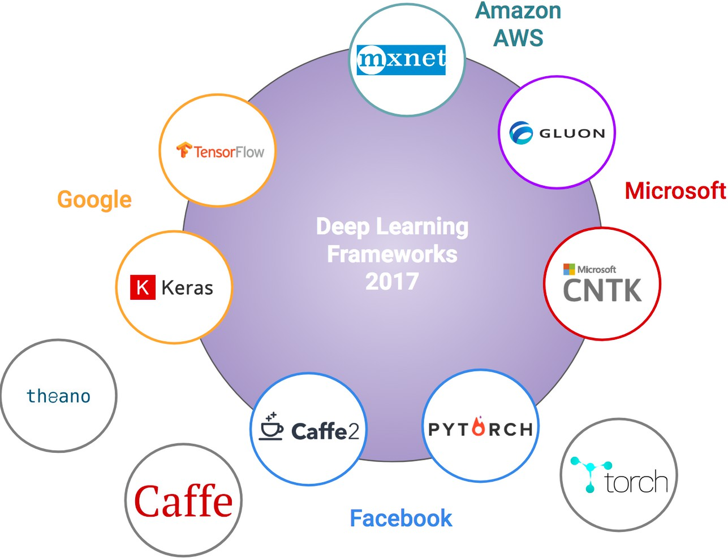
DL Frameworks include Optimization
Frameworks offer building blocks
For designing, training, validating deep nets through a high level programming interface
Optimized for performance
Provide parallelization for GPUs
Visualization of network modeling & interface
Example: Keras
An open source neural network library written in Python
It is capable of running on top of TensorFlow
Contains implementations of building blocks, such as
Layers
Objectives
Activation functions
Optimizers
Tools to make working with image and text data easier
8

Slide 9
Keras for MNIST Neural Network
# Neural Network
import keras
from keras.datasets import mnist
from keras.layers import Dense
from keras.models import Sequential
(x_train, y_train), (x_test, y_test) = mnist.load_data()
num_classes=10
image_vector_size=28*28
x_train = x_train.reshape(x_train.shape[0], image_vector_size)
x_test = x_test.reshape(x_test.shape[0], image_vector_size)
y_train = keras.utils.to_categorical(y_train, num_classes)
y_test = keras.utils.to_categorical(y_test, num_classes)
image_size = 784 model = Sequential()
model.add(Dense(units=32, activation='sigmoid', input_shape=(image_size,)))
model.add(Dense(units=num_classes, activation='softmax'))
model.compile(optimizer='sgd', loss='categorical_crossentropy',metrics=['accuracy'])
history = model.fit(x_train, y_train, batch_size=128, epochs=10, verbose=False,validation_split=.1)
loss,accuracy = model.evaluate(x_test, y_test, verbose=False)
9

Slide 10
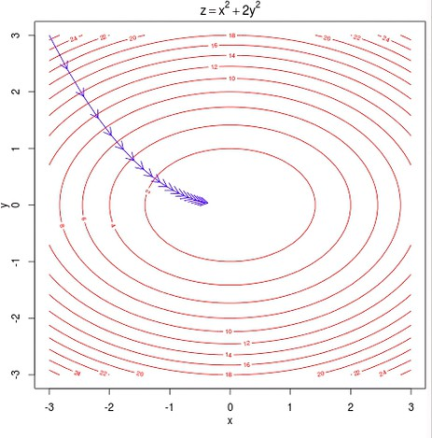
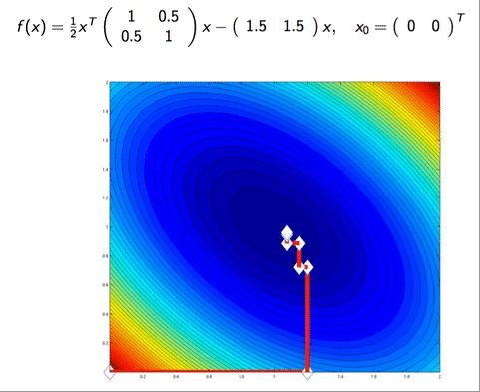
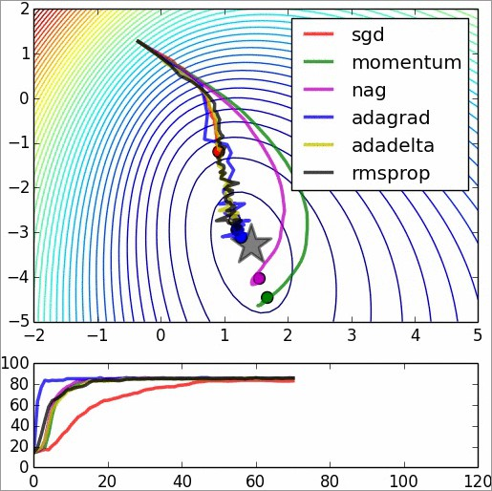
Summary of Optimization Methdos
Movies:
http://hduongtrong.github.io/2015/11/23/coordinate-descent/
Gradient Descent Coordinate Descent SGD
Minimize f(x) wrt a single variable, x_{i}, then wrt x_{j} etc
M
∑ ( )
i=1
m '
( )
g = ¹ ∇
(i ) (i )
L x ,y , θ
g = ¹ ∇
_{θ} ∑
i=1
(i ) (i )
M
θ
m '
L x ,y , θ
θ ← θ − εg
θ ← θ − εg

Slide 11
How Learning Differs from Optimization
1

Slide 12
Topics in Optimization
Optimization for Training Deep Models: Overview
How learning differs from optimization
Risk, empirical risk and surrogate loss
Batch, minibatch, data shuffling
Challenges in neural network optimization
Basic Algorithms
Parameter initialization strategies
Algorithms with adaptive learning rates
Approximate second-order methods
Optimization strategies and meta-algorithms
2

Slide 13
Topics in Learning vs Optimization
Learning vs Pure Optimization
Empirical Risk Minimization
Surrogate Loss Functions and Early Stopping
Batch and Minibatch Algorithms
3

Slide 14
Learning vs Pure Optimization
Optimization algorithms for differ from traditional optimization in several ways:
Machine learning acts indirectly
We care about some performance measure P defined wrt the training set which may be intractable
We reduce a different cost function J(θ) in the hope that doing so will reduce P
Pure optimization: minimizing J is a goal in itself
Optimizing algorithms for training Deep models:
Includes specialization on specific structure of ML objective function

Slide 15
Typical Cost Function
Typically the cost function can be written as an average over a training set
(L(f (x;θ ),y ))
^{J(θ )=E}(x ,y )~pˆ
– Where
data
L is the per-example loss function
f (x ; θ ) is the predicted output when the input is x
is the empirical distribution
pˆ
data
– In supervised learning y is target output

Slide 16
Typical Cost Function
We consider the unregularized supervised case
– where arguments of L are f (x ; θ ) and y
Trivial to extend to cases:
Where parameters θ and input x are arguments or
Exclude output y as argument
– For regularization or unsupervised learning

Slide 17
Objective wrt data generation is risk
Objective function wrt training set is
(L(f (x;θ ),y ))
L is the per-example loss function
J(θ )=E
(x ,y )~pˆ_{data}
We would prefer to minimize the corresponding objective function where expectation is across the data generating distribution p_{data} rather than over finite training set
J* (θ )=E_{(x ,y )~p} (L(f (x;θ ),y ))
data
– The goal of a machine learning algorithm is to reduce this expected generalization error
This quantity is known as risk
7

Slide 18
Empirical Risk
J* (θ )=E_{(x ,y )~p} (L(f (x;θ ),y ))
data
True risk is
If we knew p_{data}(x,y) it would be optimization solved by an optimization algorithm
When we do not know p_{data}(x,y) but only have a training set of samples, we have a machine learning problem
Empirical risk, with m training examples, is
(L(f (x;θ ),y ))= ¹ ∑L(f (x^{(i)};θ ),y^{(i)} )
J(θ )=E
m
(x ,y )~pˆ_{data}
^{m} i=1

Slide 19
Empirical Risk Minimization
Empirical risk, with m training examples, is
(L(f (x;θ ),y ))= ¹ ∑L(f( x^{(i)};θ ),y^{(i)} )
J(θ )=E
m
(x ,y )~pˆ_{data}
^{m} i=1
Which is the average training error
– Still similar to straightforward optimization
But empirical risk minimization is not very useful:
Prone to overfitting: can simply memorize training set
SGD is commonly used, but many useful loss functions have 0-1 loss, with no useful derivatives (derivative is either 0 or undefined everywhere)
We must use a slightly different approach
– Quantity we must optimize is even more different from what we truly want to optimize

Slide 20
Surrogate Loss: Log-likelihood
Exactly minimizing 0-1 loss is typically intractable (exponential in the input dimension) even for a linear classifier
In such situations use a surrogate loss function
Acts has a proxy but has advantages
Negative log-likelihood of the correct class is a surrogate for 0-1 loss
It allows model to estimate conditional probability of classes given the input
If it does that well then can pick the classes that yield the least classification error in expectation

Slide 21
Surrogate may learn more
Using log-likelihood surrogate,
Test set 0-1 loss continues to decrease for a long time after the training set 0-1 loss has reached zero when training
Because one can improve classifier robustness by further pushing the classes apart
Results in a more confident and robust classifier
Thus extracting more information from the training data than with minimizing 0-1 loss

Slide 22
Learning does not stop at minimum
Important difference between Optimization in general and Optimization for Training:
Training does not halt at a local minimum
Early Stopping: Instead Learning algorithm halts on an early stopping criterion
Based on a true underlying loss function
– Such as 0-1 loss measured on a validation set
Designed to cause algorithm to stop overfitting
Often stops when derivatives are still large
In pure optimization, algorithm considered to converge when derivatives are very small

Slide 23
Decomposition: Batch Algorithms
Objective function decomposes as a sum over training examples
This is unlike pure optimization
Optimization for learning:
update the parameters based the expected value of cost using only a subset of the terms of of the full cost function

Slide 24
Ex: Decomposition into a sum
Maximum likelihood estimation problem
In log-space estimated parameter decomposes into a sum over each example
m
_{(x}(i)_{,y}(i)_{;θ )}
θ = arg max∑log p
ML model
θ
i=1
Maximizing this sum is equivalent to maximizing the
expectation over the empirical distribution defined by the
training set
J( θ)=E_{x ,y~pˆ} log p_{model} (x,y;θ )
data
Commonly used property of J(θ) is its gradient
∇_{θ}J( θ)=E_{x,y~pˆ} ∇_{θ} log p_{model} (x,y;θ )
data
Computing this expectation is very expensive
Requires summation over every training sample
Solution: randomly sample small no. of samples

Slide 25
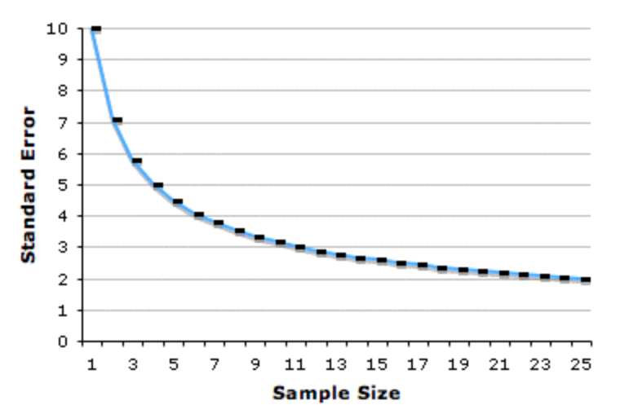
Quality of sampling-based estimate
Standard error for mean from n samples is
– where σ is std dev of samples
σ
n
– Denominator shows that error decreases less than
linearly with no. of samples
Ex: 100 samples vs 10,000 samples
σ=10
Computation increases by factor of 100 but
Error decreases by only a factor of 10
Optimization algorithms converge much faster
if allowed to rapidly compute approximate estimates
rather than slowly compute exact gradient

Slide 26
A motivation for sampling: Redundancy
Training set may be redundant
Worst case: all m examples are identical
Sampling based estimate could use m times less computation
In practice
unlikely to find worst case situation but
likely to find large no. of examples that all make similar contribution to gradient

Slide 27
Batch gradient methods
Batch or deterministic gradient methods:
Optimization methods that use all training samples in a large batch
Somewhat confusing terminology
Batch also used to describe minibatch used by minibatch stochastic gradient descent
Batch gradient descent implies use of full training set
Batch size refers the size of a minibatch

Slide 28
Stochastic or online methods
Those using a single sample are called
stochastic or on-line
– On-line typically means continually created samples, rather than multiple passes over a fixed size training set
algorithms use more than 1 but fewer than all
Traditionally called minibatch or minibatch stochastic or simply stochastic

Slide 29
Minibatch Size
Driven by following factors
Larger batches→more accurate gradient but with less than linear returns
Multicore architectures are underutilized by extremely small batches
Use some minimum size below which there is no reduction in time to process a minibatch
If all examples processed in parallel, amount of memory scales with batch size
This is a limiting factor in batch size
GPU architectures more efficient with power of 2
Range from 32 to 256, sometimes with 16 for large models

Slide 30
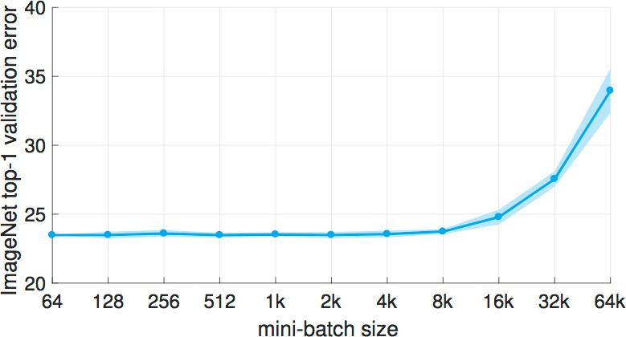
Distributed synchronous SGD
ImageNet dataset large minibatches cause optimization difficulties, but when these are addressed the trained networks exhibit good generalization.
Specifically, no loss of accuracy when training with large minibatch sizes up to
8192 images.
https://arxiv.org/pdf/1706.02677.pdf

Slide 31
Regularizing effect of small batches
Small batches offer regularizing effect due to noise added in process
Generalization is best for batch size of 1
Small batch sizes require small learning rate
To maintain stability due to high variance in estimate of gradient
Total run time can be high
Due to reduced learning rate and
Requires more time to observe entire training set

Slide 32
Use of minibatch information
Different algorithms use different information from the minibatch
– Some algorithms more sensitive to sampling error
Algorithms using gradient g are robust and can handle smaller batch sizes like 100
Second order methods using Hessian H and compute updates such as H⁻¹ g require much larger batch sizes like 10,000

Slide 33
Random selection of minibatches
Crucial to select minibatches randomly
Computing expected gradient from a set of samples requires that sample independence
Many data sets are arranged with successive samples highly correlated
E.g., blood sample data set has five samples for each patient
Necessary to shuffle the samples
For a data set with billions of samples shuffle once
and store it in shuffled fashion
23

Slide 34
Simple random sampling
Define the population. Say, training set has
10,000 examples
Choose your batch size: say 100
List the population and assign numbers to them
Use a random number generator to generate a number in [1,1000]
Select your sample

Slide 35
Parallelization of minibatches
We can computer entire separate updates over different examples in parallel
– Compute update that minimizes J(X) for one minibatch of examples X at the same time we compute update for several other minibatches
Synchronous parallel distributed approaches discussed in Section 12.1.3

Slide 36
SGD and generalization error
Minibatch SGD follows the gradient of the true
generalization error
(L( f (x;θ ), y))
J *(θ ) = E_{( x , y )~p}
data
– As long as the examples are repeated
Implementations of minibatch SGD
Shuffle once and pass through multiple no. of times
On the first pass: each minibatch computes unbiased estimate of true generalization error
Second pass: estimate is more biased because it is formed by resampling values already used rather than fair samples from data generating distribution

Slide 37
SGD minimizes generalization error
Easiest to see equivalence in online learning
Examples/minibatches are drawn from a stream
Similar to living being who sees a new example at each instant
with each example (x,y) coming from data generating distribution p_{data} (x,y)
» Examples never repeated, every example is a fair sample
Equivalence is easy to derive when x and y are discrete
As seen next

Slide 38
Discrete case with loss function
Generalization error (in terms of loss function)
is
J *(θ ) = E_{( x , y )~p} (L( f (x;θ ), y))
data
– Which can be written as a sum
J *(θ ) = ∑∑p_{data}(x , y)L( f (x;θ ), y)
x y
– with exact gradient
g = ∇J *(θ ) = ∑∑p_{data}(x, y)∇_{θ} L( f (x;θ ), y)
Implies that derivative can be computed in batches
x y
We have already seen this (decomposition) demonstrated for log-likelihood in
J(θ) = E_{x , y~pˆ} log p_{model} (x , y;θ )
data
∇_{θ} J(θ) = E_{x , y~pˆ} ∇_{θ} log p_{model} (x , y;θ )
data
and
Thus it holds for functions other than likelihood
Similar result for when x and y are continuous
28

Slide 39
Use of multiple epochs
SGD minimizes generalization error when samples are not reused
Yet best to make several passes through the training set
Unless training set is extremely large
With multiple epochs, first epoch follows unbiased gradient of generalization error
Additional epochs provide enough benefit to decrease training error
Although increasing gap between training and testing error

Slide 40
Impact of growing data sets
Data sets are growing more rapidly than computing power
More common to use each training example only once
Or even make an incomplete pass through the data set
With a large training set overfit is not an issue
Underfitting and computational efficiency become predominant concerns
30

Slide 41
Challenges in Neural Network Optimization
1

Slide 42
Topics in Optimization for DL
Importance of Optimization in machine learning
How learning differs from optimization
Challenges in neural network optimization
Basic Optimization Algorithms
Parameter initialization strategies
Algorithms with adaptive learning rates
AdaGrad, RMSPro, Adam
Choosing the right optimization algorithm
Approximate second-order methods
Optimization strategies and meta-algorithms
2

Slide 43
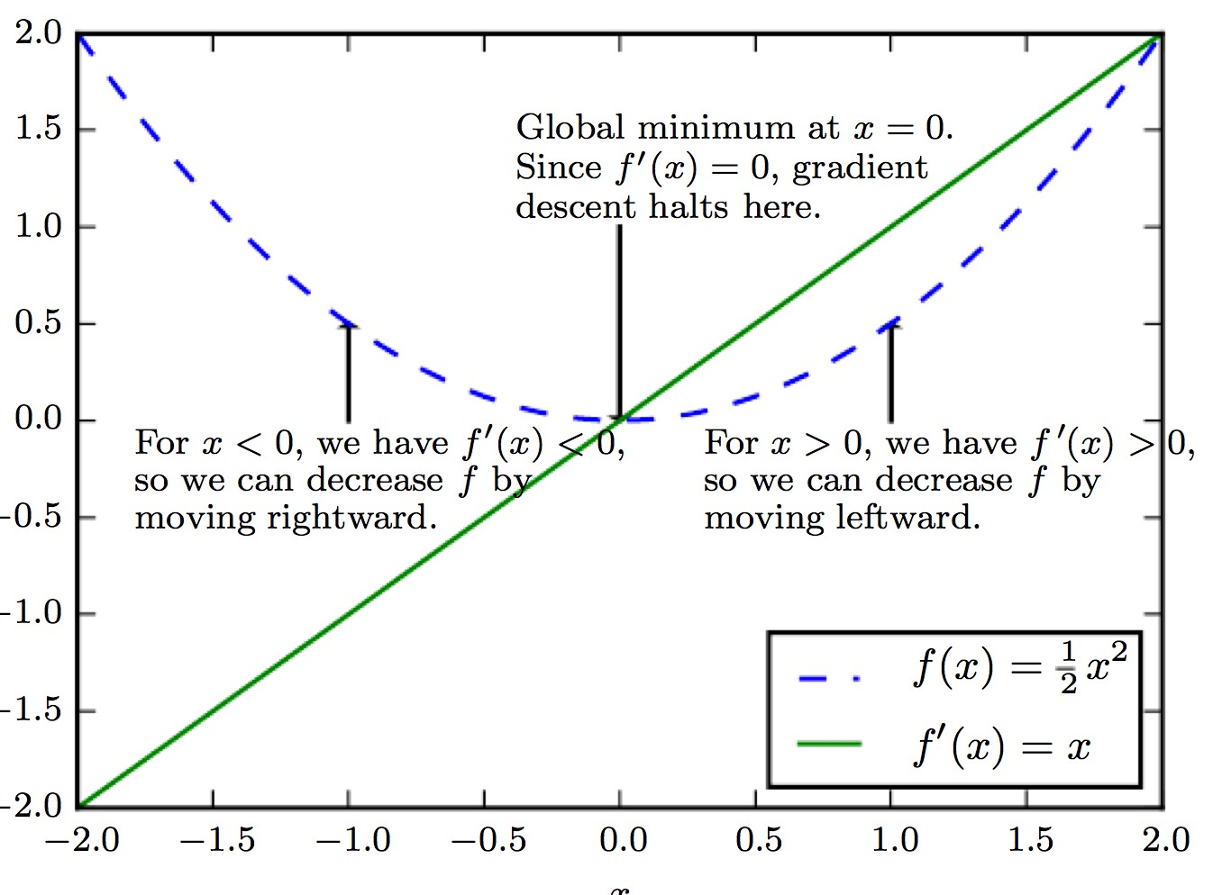
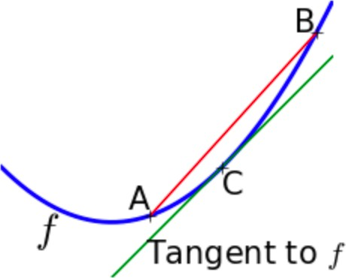

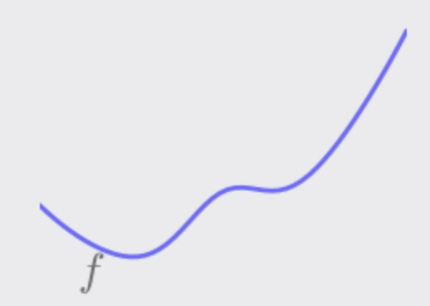
Optimization is a difficult task
Optimization is an extremely difficult task
– Traditional ML: careful design of objective function and constraints to ensure convex optimization
– When training neural networks, we must confront the nonconvex case
3

Slide 44
Challenges in Optimization
Summary of challenges in optimization
Ill-conditioning
Local minima
Plateaus, saddle points and other flat regions
Cliffs and exploding gradients
Long-term dependencies
Inexact gradients
Poor correspondence between local & global structure
Theoretical limits of optimization
4

Slide 45
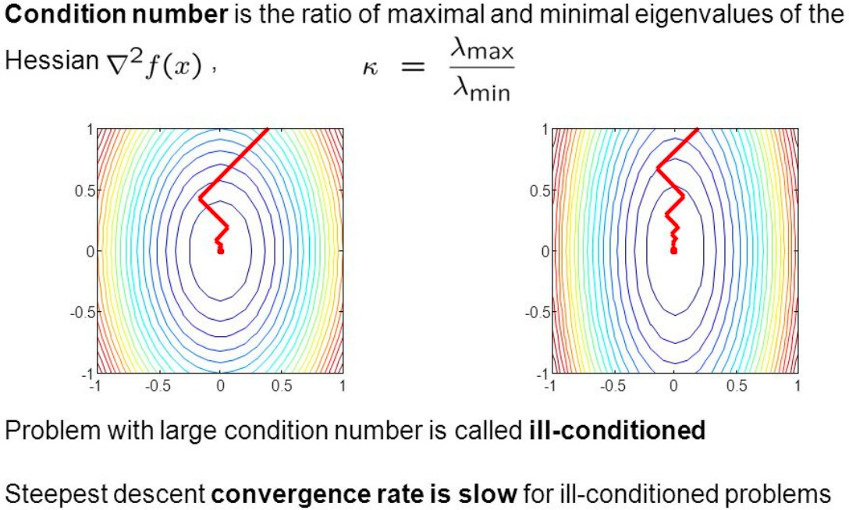
1. Ill-conditioning of the Hessian
Even when optimizing convex functions one problem is an ill conditioned Hessian matrix, H
– Very general problem in optimization, convex or not
Source: https://slideplayer.com/slide/4916524/

Slide 46
Result of Ill-conditioning
Causes SGD to be stuck: even very small steps cause increase in cost function
– Gradient descent step of –εg
f (x) ≈ f (x⁽⁰⁾) +(x - x⁽⁰⁾)^{T} g + ¹ (x - x⁽⁰⁾)^{T} H(x - x⁽⁰⁾) 2 Substituting x=x⁽⁰⁾-εg
 | f (x⁽⁰⁾ − εg) ≈ f (x⁽⁰⁾) − εg^{T}g + ¹ ε²g^{T}Hg 2
will add to the cost
−εg^{T}g + ¹ ε²g^{T}Hg
2
– Ill conditioning becomes a problem when
¹ ε²g^{T}Hg > εg^{T}g
2
To determine whether ill-conditioning is detrimental monitor g^{T}g and g^{T}Hg terms
Gradient norm doesn’t shrink but g^{T}Hg grows order of magnitude
Learning becomes very slow despite a strong gradient

Slide 47
2. Local Minima
In convex optimization, problem is one of finding a local minimum
Some convex functions have a flat region rather than a global minimum point
Any point within the flat region is acceptable
With non-convexity of neural nets many local minima are possible
Many deep models are guaranteed to have an extremely large no. of local minima
This is not necessarily a major problem
7

Slide 48
Model Identifiability
Model is identifiable if large training sample set can rule out all but one setting of parameters
Models with latent variables are not identifiable
Because we can exchange latent variables
– If we have m layers with n units each there are n!^{m} ways of arranging the hidden units
This non-identifiability is weight space symmetry
Another is scaling incoming weights and biases
By a factor α and scale outgoing weights by 1/α
Even if a neural net has uncountable no. of minima, they are equivalent in cost
– So not a problematic form of non-convexity
8

Slide 49
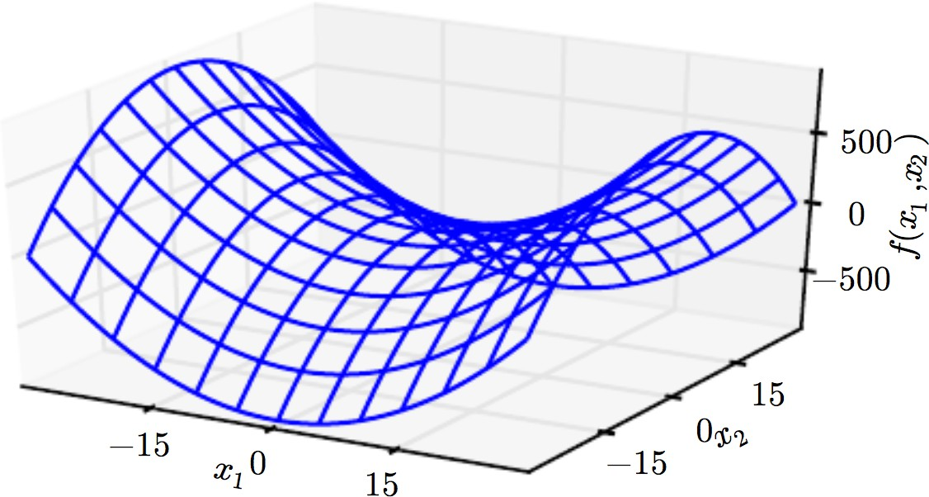
3. Plateaus, Saddle Points etc
More common than local minima/maxima are:
Another kind of zero gradient points: saddle points
At saddle, Hessian has both positive and negative values
Positive: cost greater than saddle point
Negative values have lower value
In low dimensions:
– Local minima are more common
In high dimensions:
Contains both positive and negative curvature
Function is f(x)=x ²-x ²
1 2
– Local minima are rare, saddle points more common
For Newton’s saddle points pose a problem
– Explains why second-order methods have not replaced gradient descent
9

Slide 50


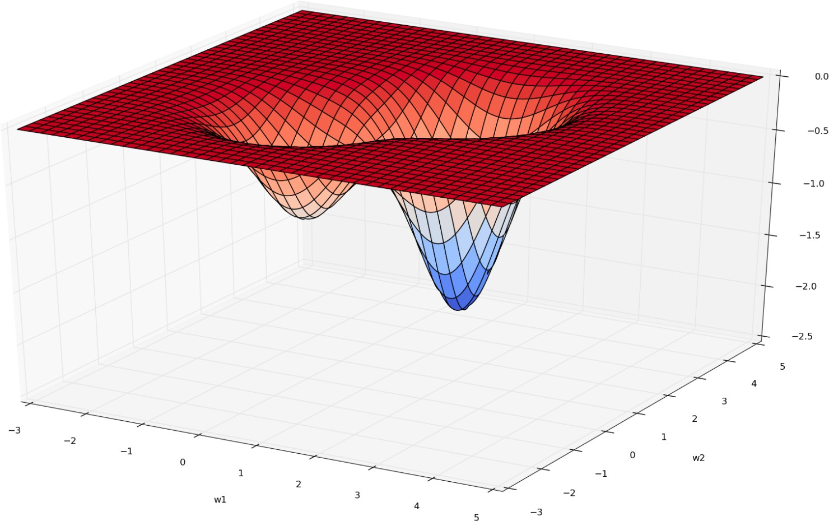
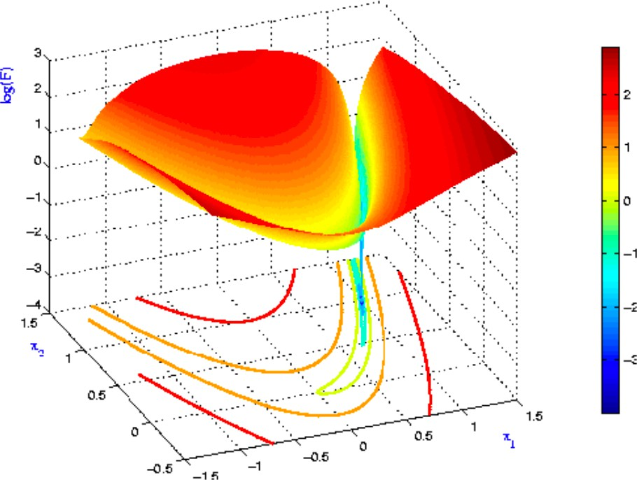
Plateau and Ravine
10

Slide 51
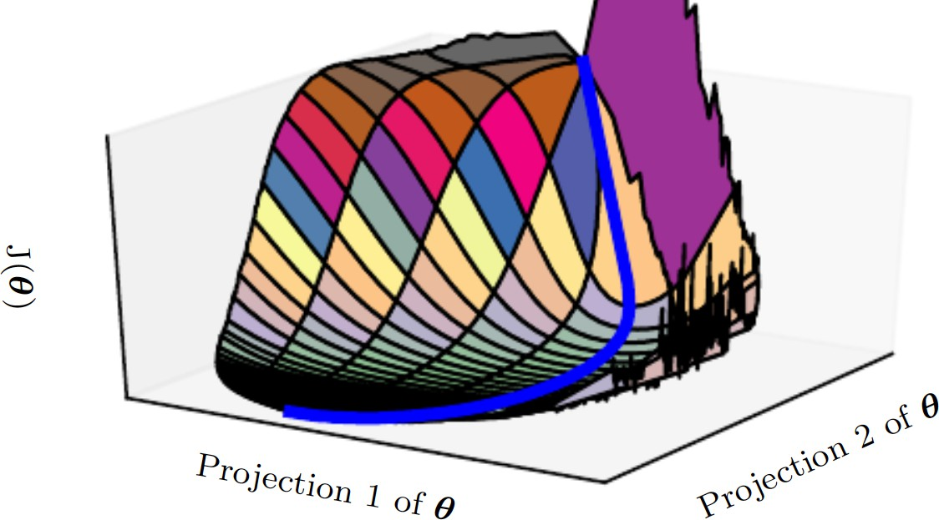
Cost Function of Neural Network
Visualizations are similar for
Feedforward networks
Convolutional networks
Recurrent networks
Applied to object recognition and NLP tasks
Primary obstacle is not multiple minima but saddle points
Most of training time spent on traversing flat valley of the Hessian matrix or circumnavigating
tall “mountain” via an indirect arcing path
11

Slide 52
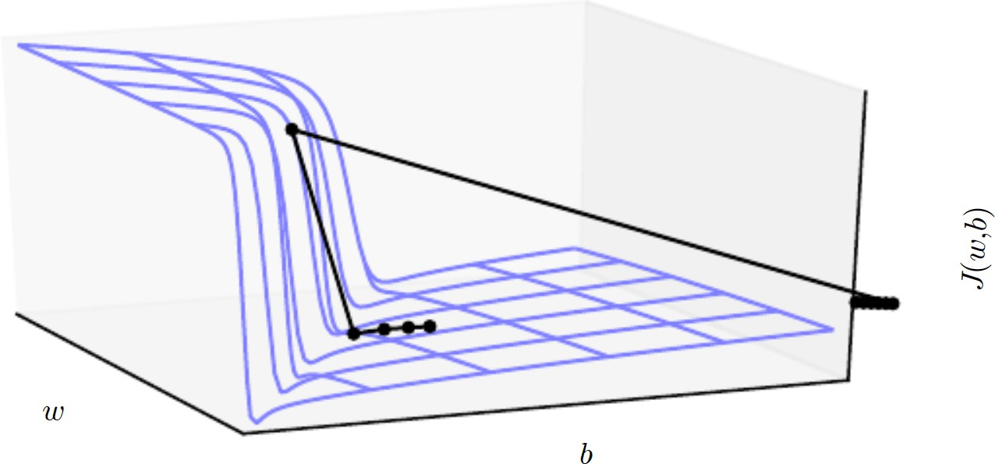
4.Cliffs and Exploding Gradients
Neural networks with many layers
Have steep regions resembling cliffs
Result from multiplying several large weights
E.g., RNNs with many factors at each time step
Gradient update step can move parameters extremely far, jumping off cliff altogether
Cliffs dangerous from either direction
Gradient clipping heuristics can be used
12

Slide 53
5. Long-Term Dependencies
When computational graphs become extremely deep, as with
feed-forward networks with many layers
RNNs which construct deep computational graphs by repeatedly applying the same operation at each time step
Repeated application of same parameters gives rise to difficulties
Discussed further with RNNs in 10.7
13

Slide 54
6. Inexact Gradients
Optimization algorithms assume we have access to exact gradient or Hessian matrix
In practice we have a noisy or biased estimate
Every algorithm relies on sampling- based estimates
In using minibatch of training examples
In other case, objective function is intractable
In which case gradient is intractable as well
Contrastive Divergence gives a technique for approximating the gradient of the intractable log- likelihood of a Boltzmann machine
14

Slide 55
7. Poor Correspondence between Local and Global Structure
It can be difficult to make a single step if:
J(θ) is poorly conditioned at the current point θ
θ lies on a cliff
θ is a saddle point hiding the opportunity to make progress downhill from the gradient
It is possible to overcome all these problems and still perform poorly
if the direction that makes most improvement locally does not point towards distant regions of much
lower cost
15

Slide 56
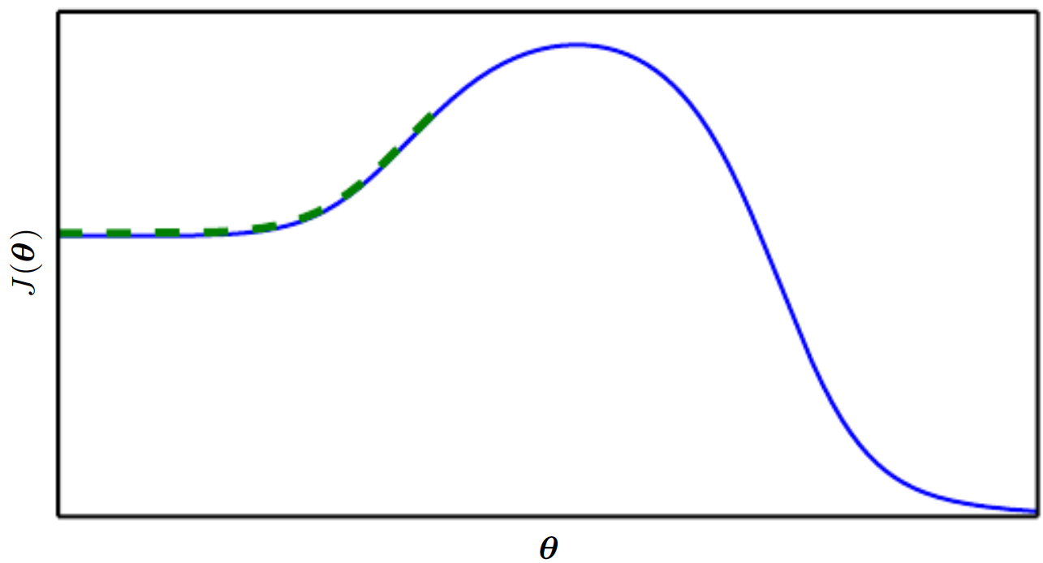
Need for good initial points
Optimization based on local downhill moves can fail if local surface does not point towards the global solution
Research directions are aimed at finding good initial points for problems with a difficult global structure
Ex: no saddle points or local minima
Trajectory of circumventing
such mountains may be long and result in
excessive training time
16

Slide 57
8. Theoretical Limits of Optimization
There are limits on the performance of any optimization algorithm we might design for neural networks
These results have little bearing on the use of neural networks in practice
Some apply only to networks that output discrete values
Most neural networks output smoothly increasing values
Some show that there exist problem classes that are intractable
But difficult to tell whether problem falls in thet class
17

Slide 58
Basic Optimization Algorithms

Slide 59
Topics
Importance of Optimization in machine learning
How learning differs from optimization
Challenges in neural network optimization
Basic Optimization Algorithms
SGD, Momentum, Nesterov Momentum
Parameter initialization strategies
Algorithms with adaptive learning rates
AdaGrad, RMSProp, Adam
Approximate second-order methods
Optimization strategies and meta-algorithms

Slide 60
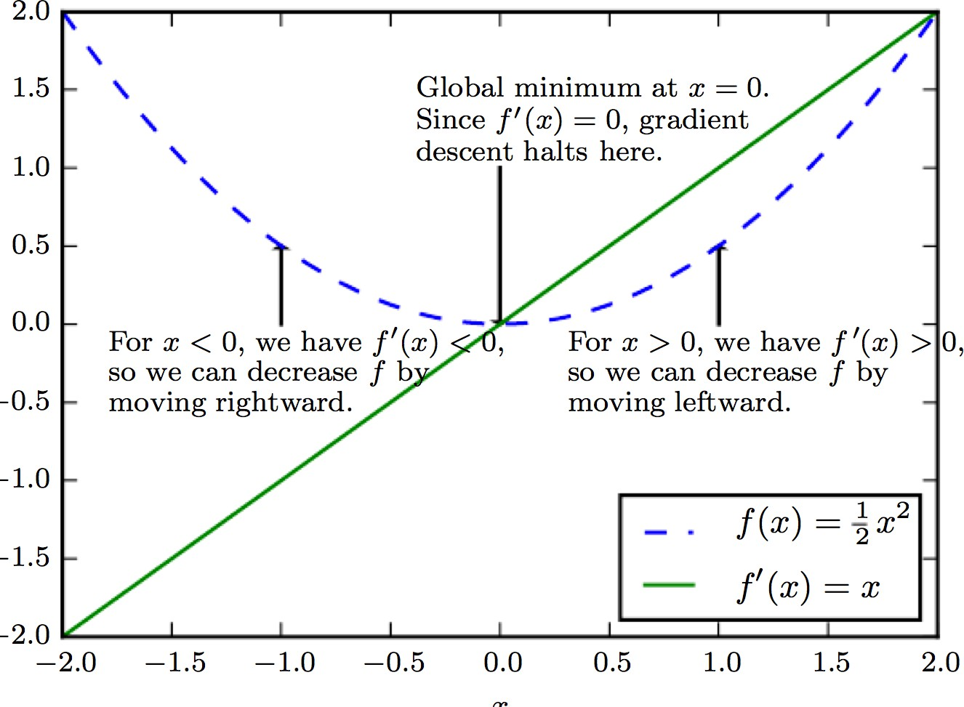
1. Stochastic Gradient Descent
Gradient descent follows gradient of entire training set downhill
Criterion f(x) minimized by moving from current solution in direction of the negative of gradient
SGD: Accelerated by minibatches downhill
Wide use for ML in general and for
Average gradient on a minibatch is an estimate of the gradient
3

Slide 61
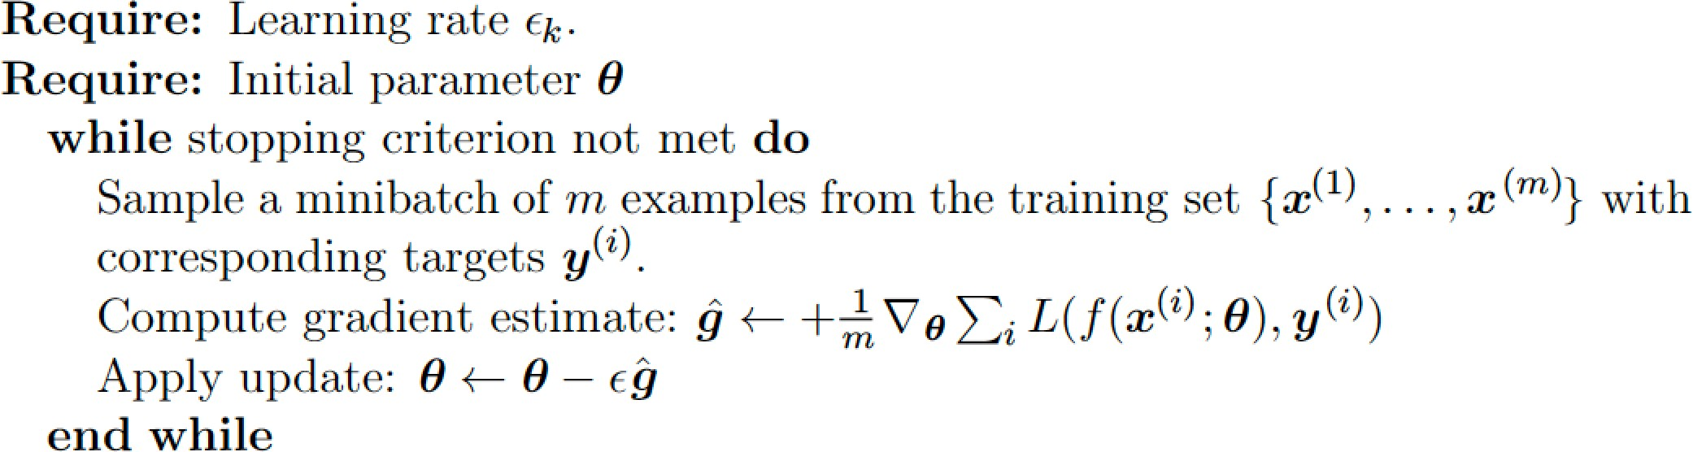
SGD follows gradient estimate downhill
Algorithm: SGD update at training iteration k
A crucial parameter is the learning rate ε
At iteration k it is ε_{k}

Slide 62
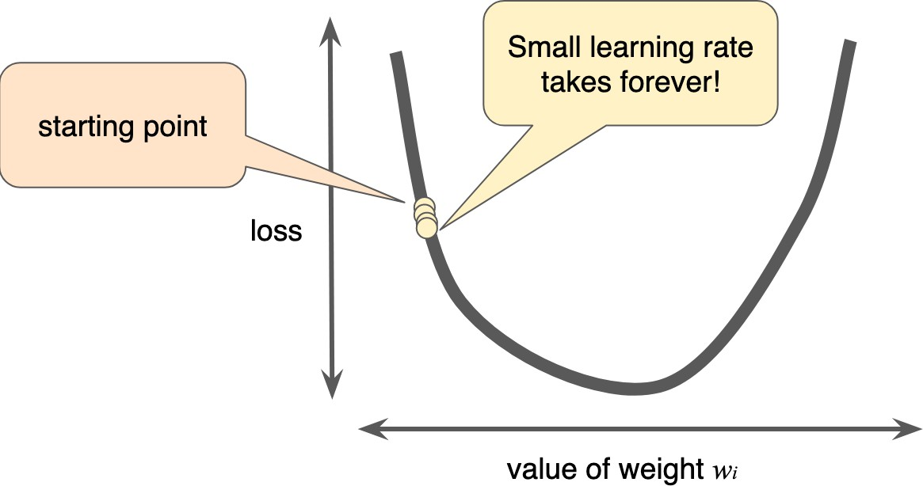
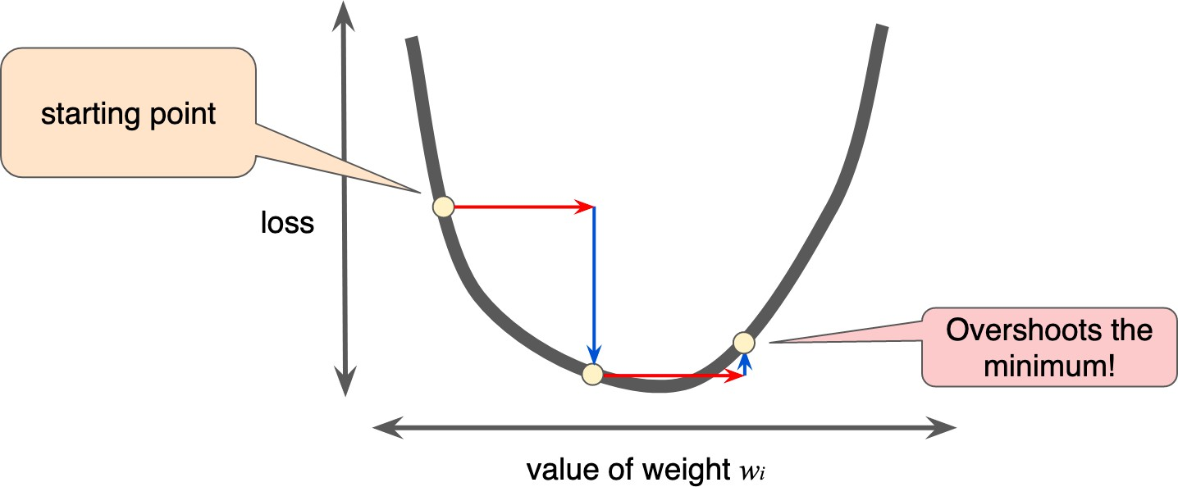
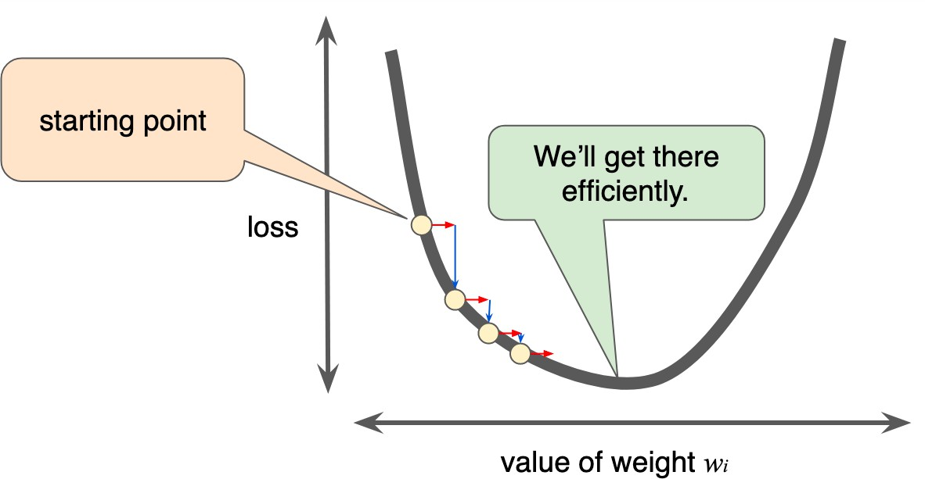
Choice of learning rate
Too small learning rate will take too long
Too large, the next point will perpetually bounce haphazardly across the bottom of the well
If gradient is small then you
can safely try a larger learning rate, which compensates for the small gradient and results in a larger step size

Slide 63
Learning rate in Keras
Keras provides SGD class to implement SGD optimizer with learning rate and momentum
The default learning rate is 0.01 and no momentum used

Slide 64
Need for decreasing learning rate
True gradient of total cost function
Becomes small and then 0
We can use a fixed learning rate
But SGD has a source of noise
Random sampling of m training samples
Gradient does not vanish even when arrive at a minimum
Sufficient condition for SGD convergence
∞ ∞
∑ε = ∞
∑
2
k
k
ε < ∞
k =1 k =1
Common to decay learning rate linearly until iteration τ: ε_{k}=(1-α)ε₀+αε_{τ} with α=k/τ
After iteration τ, it is common to leave ε constant
Often a small positive value in the range 0.0 to 1.0
7

Slide 65
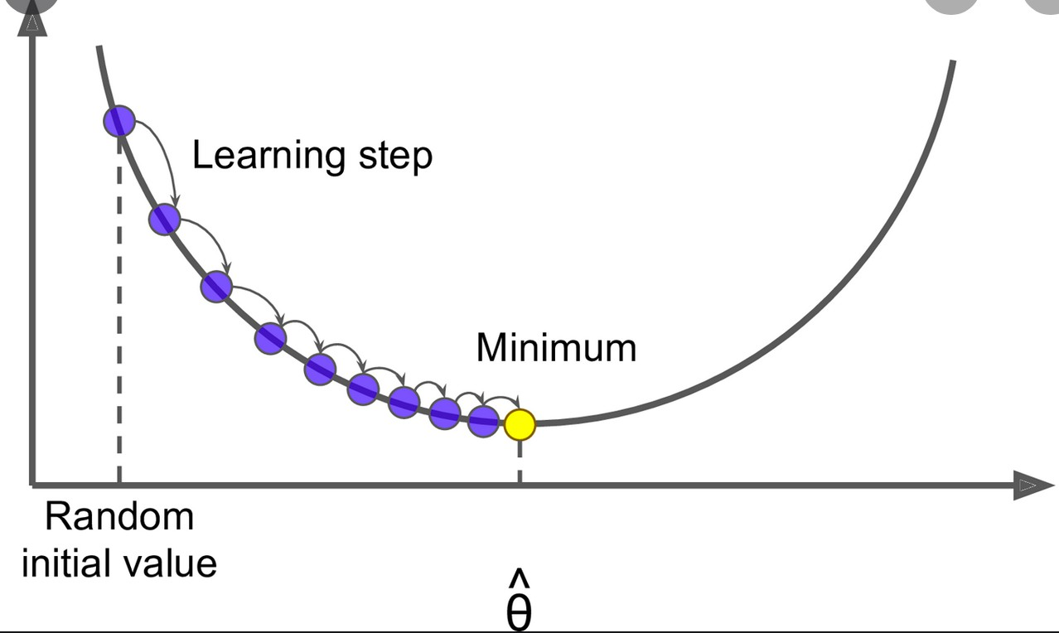
Learning Rate Decay
Decay learning rate
τ: ε_{k}=(1-α)ε₀+αε_{τ} with α=k/τ
Learning rate is calculated at each update
(e.g. end of each mini-batch) as follows:
Where lrate is learning rate for current epoch
initial_lrate is specified as an argument to SGD
decay is the decay rate which is greater than zero and
iteration is the current update number

Slide 66
2. The Momentum method
SGD is a popular optimization strategy
But it can be slow
Momentum method accelerates learning, when:
Facing high curvature
Small but consistent gradients
Noisy gradients
Algorithm accumulates moving average of past gradients and move in that direction, while exponentially decaying

Slide 67
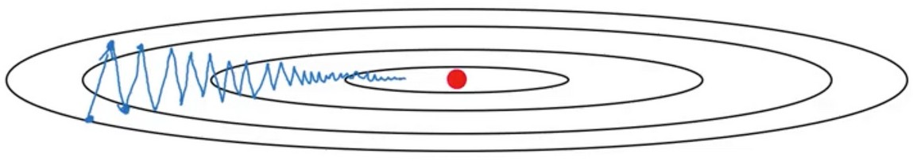
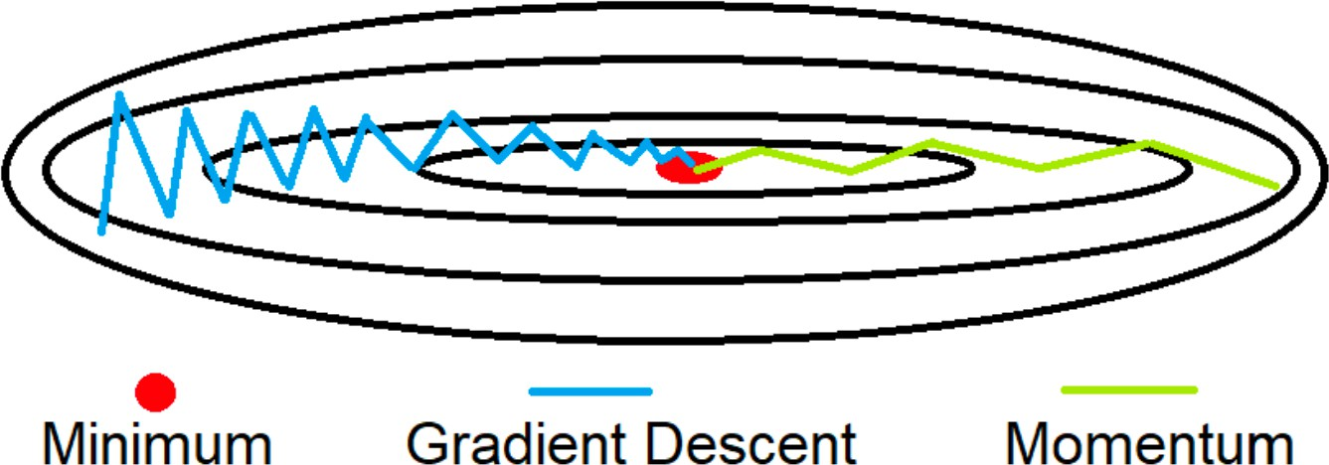
Gradient Descent with momentum
Gradient descent with momentum converges faster than standard gradient descent
Taking large steps in w₂ direction and small steps in w₁ direction slows down algorithm
w₂
w₁
Momentum reduces oscillation in w₂ direction
We can set a higher learning rate
10

Slide 68
Momentum definition
Introduce variable v, or velocity
It is the direction and speed at which parameters move through parameter space
Momentum in physics is mass times velocity
The momentum algorithm assumes unit mass
A hyperparameter α ε [0,1) determines exponential decay

Slide 69
Momentum update rule
The update rule is given by
⎛
∑ ( )
⎞
⎥⎠
v ← αv − ε∇
θ ← θ + v
1
m
(i )
(i )
L f (x ; θ ,y
^{θ ⎜}⎝ ^{m} i =1
The velocity v accumulates the gradient
elements
⎛
1
m
( )
⎞
⎥⎠
∇
∑
(i ) (i )
L f (x ; θ ,y
^{θ ⎜}⎝ ^{m} i =1
The larger α is relative to ε, the more previous gradients affect the current direction
The SGD algorithm with momentum is next

Slide 70
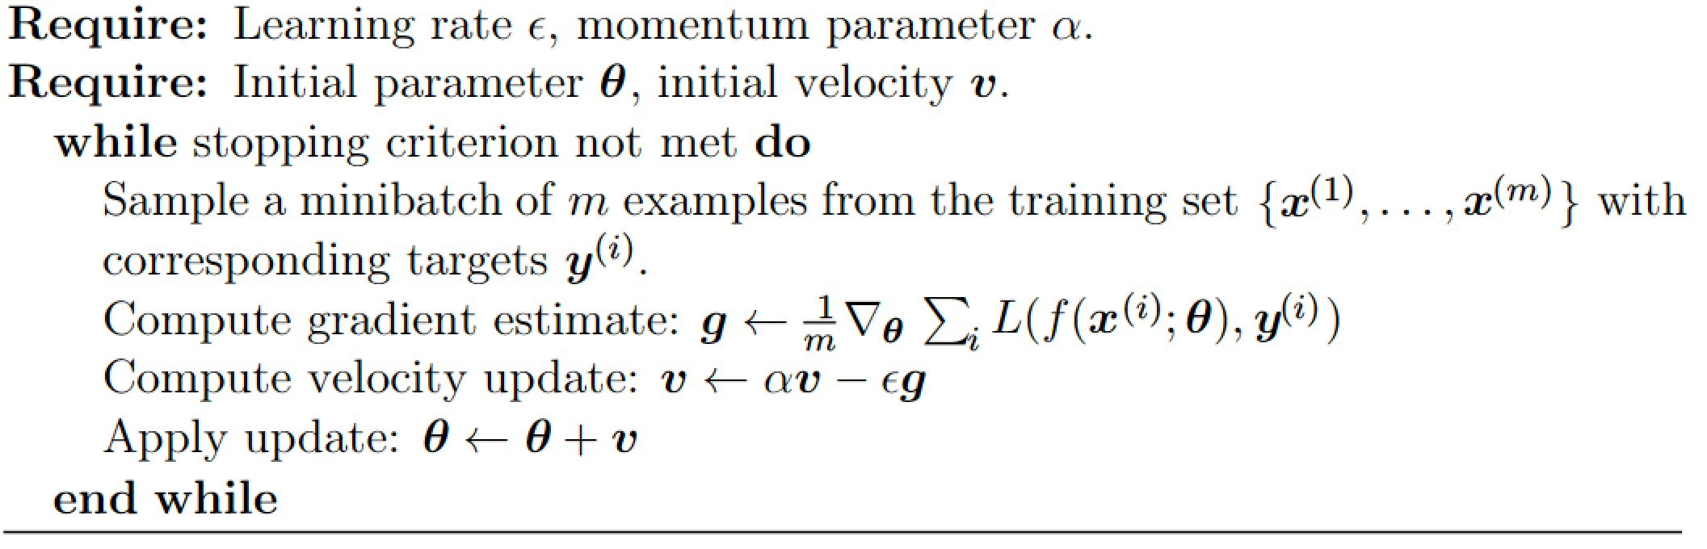
SGD algorithm with momentum
Algorithm: SGD with momentum
Keras: The learning rate can be specified via the lr argument and the momentum can be specified via the momentum argument.

Slide 71
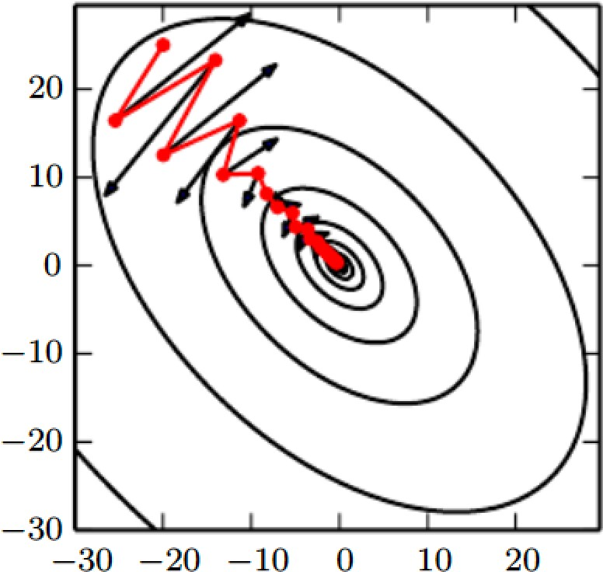
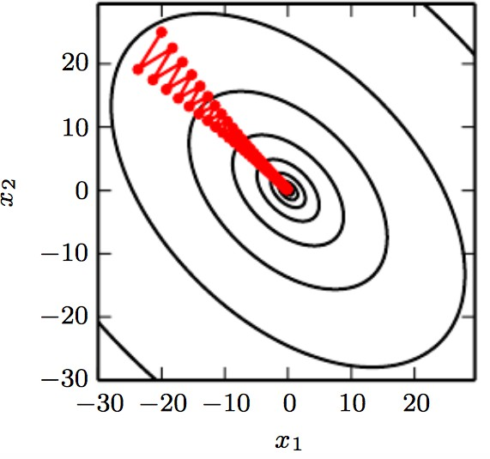
Momentum
SGD with momentum
Contour lines depict a quadratic loss function With a poorly conditioned Hessian matrix Red path cutting across the contours depicts path followed by momentum learning rule as it minimizes this function
Comparison to SGD without momentum
At each step we show path that would be taken by SGD at that step
Poorly conditioned quadratic objective Looks like a long narrow valley
with steep sides
Wastes time

Slide 72
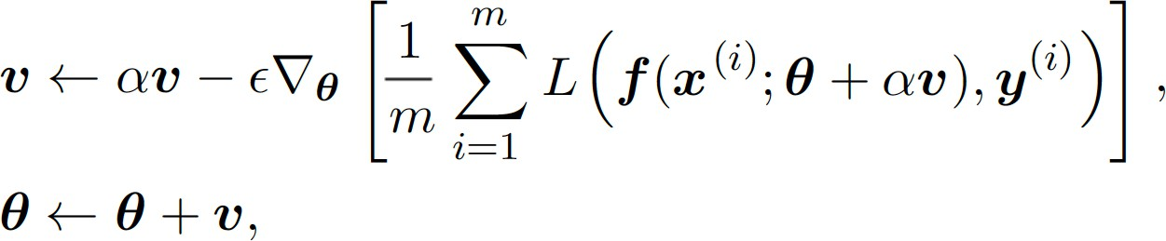
3. Nesterov Momentum
A variant to accelerate gradient, with update
where parameters α and ε play a similar role as in the standard momentum method
Difference between Nesterov and standard momentum is where gradient is evaluated.
Nesterov gradient is evaluated after the current velocity is applied.
Thus one can interpret Nesterov as attempting to add a correction factor to the standard method of momentum

Slide 73
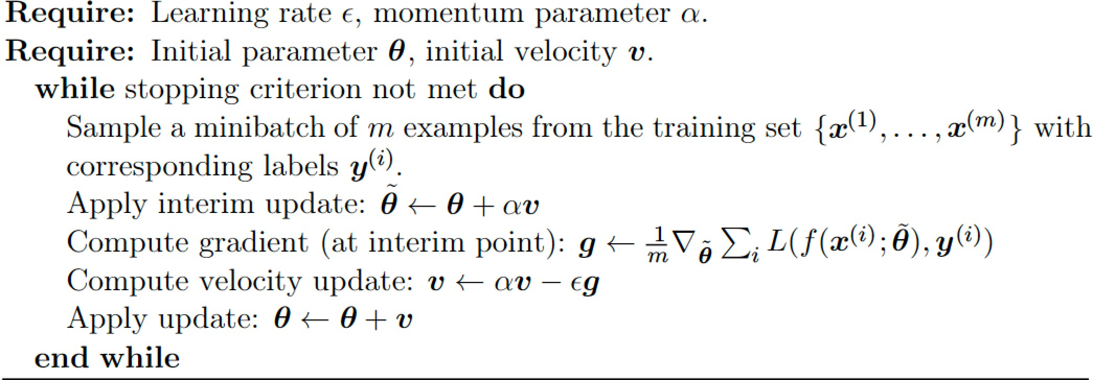
SGD with Nesterov Momentum
A variant of the momentum algorithm
– Nesterov’s accelerated gradient method
Applies a correction factor to standard method
Algorithm: SGD with Nesterov momentum
This line is added from plain momentum

Slide 74
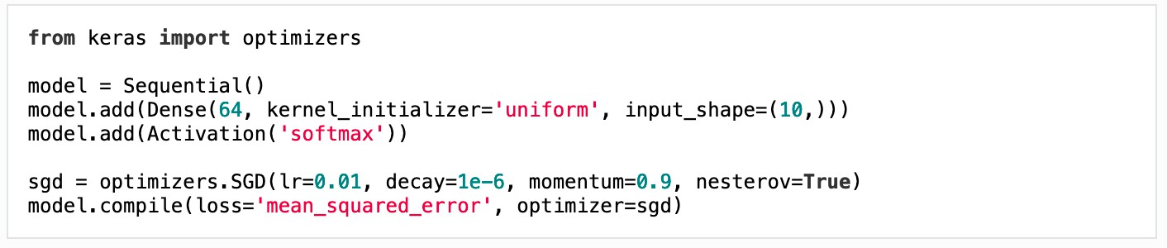
Keras SGD with Nesterov Momentum
An optimizer is one of the two arguments required for compiling a Keras model:
Arguments
learning_rate: float >= 0. Learning rate.
momentum: float >= 0. Parameter that accelerates SGD in the relevant direction and dampens oscillations.
nesterov: boolean. Whether to apply Nesterov momentum.
17

Slide 75
Parameter Initialization Strategies

Slide 76
Topics
Importance of Optimization in machine learning
How learning differs from optimization
Challenges in neural network optimization
Basic Optimization Algorithms
– SGD, Momentum, Nesterov Momentum
Parameter initialization strategies
Algorithms with adaptive learning rates
Approximate second-order methods
Optimization strategies and meta-algorithms

Slide 77
Role of Initialization
Non-iterative optimization requires no initialization
Simply solve for solution point
Iterative but converge regardless of initialization
Acceptable solutions in acceptable time
Iterative but affected by choice of Initialization
training algorithms are iterative
Initialization determines whether it converges at all
Can determine how quickly learning converges
3

Slide 78
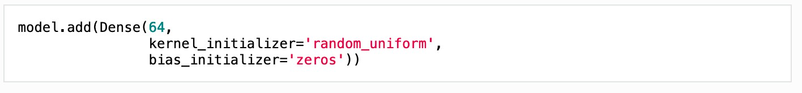
Keras Initialization
Initializations define the way to set the initial random weights of Keras layers
The keyword arguments used for passing initializers to layers will depend on the layer
Usually it is simply kernel_initializer and
bias_initializer:
4

Slide 79
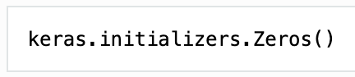
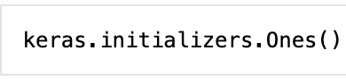
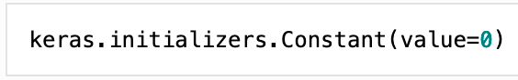
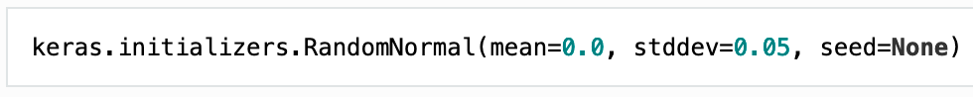
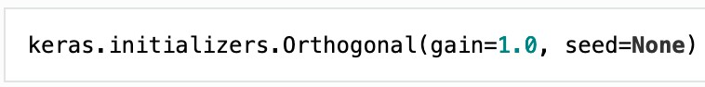
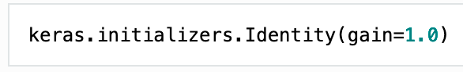
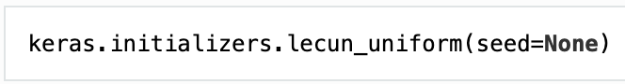
Available Initializers in Keras
Zeros
Ones
Constant
Random Normal
Random Uniform
Truncated Normal
Variance Scaling
Orthogonal
Identity
Lecun_uniform
5

Slide 80
Modern Initialization Strategies
They are simple and heuristic
Based on achieving nice properties
But problem is a difficult one
– Some initial points are beneficial for optimization but detrimental to generalization

Slide 81
Known property: Break Symmetry
Only property known with certainty: Initial parameters must be chosen to break symmetry
If two hidden units have the same inputs and same activation function then they must have different initial parameters
Usually best to initialize each unit to compute a different function
This motivates use random initialization of parameters

Slide 82
Choice of biases
Biases for each unit are heuristically chosen constants
Only the weights are initialized randomly
Extra parameters such as conditional variance of a prediction are constants like biases

Slide 83
Weights drawn from Gaussian
Weights are almost always drawn from a Gaussian or uniform distribution
Choice of Gaussian or uniform does not seem to matter much but not studied exhaustively
Scale of the initial distribution does have an effect on outcome of optimization and ability to generalize
Larger initial weights will yield stronger symmetry- breaking effect, helping avoid redundant units
Too large may result in exploding values

Slide 84
Heuristics for initial scale of weights
One heuristic is to initialize the weights of a fully connected layer with N_{in} inputs and N_{out} outputs by sampling each weights from Uniform(-r, r) where r = ¹
^{N}in
Another heuristic is normalized initiation with
6
r =
^{N}in ^{+ N}out
– Which is a compromise between the goal of initializing all layers to have the same activation variance and the goal of having all layers having the same gradient variance

Slide 85
Initialization for the biases
Bias settings must be coordinated with setting weights
Setting biases to zero is compatible with most weight initialization schemes
Situations for nonzero biases:
Bias for an output unit: initialize to obtain right marginal statistics for output
Set bias to inverse of activation function applied to the marginal statistics of the output in the training set
Choose bias to causing too much saturation at initialization

Slide 86
Algorithms with Adaptive Learning Rates
1

Slide 87
Topics
Importance of Optimization in machine learning
How learning differs from optimization
Challenges in neural network optimization
Basic Optimization Algorithms
– SGD, Momentum, Nesterov Momentum
Parameter initialization strategies
Algorithms with adaptive learning rates
AdaGrad
RMSProp
Adam
Choosing the right optimization algorithm
Approximate second-order methods
Optimization strategies and meta-algorithms
2

Slide 88
Learning Rate is Crucial
Learning rate: most difficult hyperparam to set
It significantly affects model performance
Cost is highly sensitive to some directions in parameter space and insensitive to others
Momentum helps but introduces another hyperparameter
Is there another way?
If direction of sensitivity is axis aligned, separate learning rate for each parameter and adjust them throughput learning

Slide 89
Heuristic Approaches
Delta-bar-delta Algorithm
Applicable to only full batch optimization
Method:
If partial derivative of the loss wrt to a parameter remains the same sign, the learning rate should increase
If that partial derivative changes sign, the learning rate should decrease
Recent Incremental mini-batch methods
To adapt learning rates of model parameters
AdaGrad
RMSProp
Adam

Slide 90
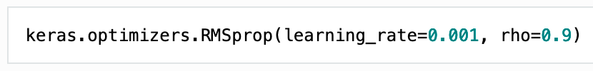
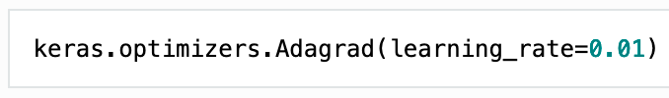
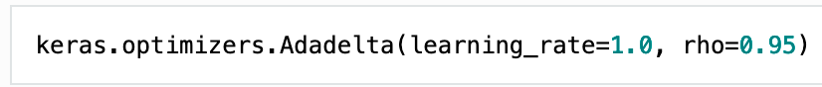
Keras Adaptive Optimizers
RMSprop
Adagrad
Adadelta
Adam
Adamax
Nadam

Slide 91
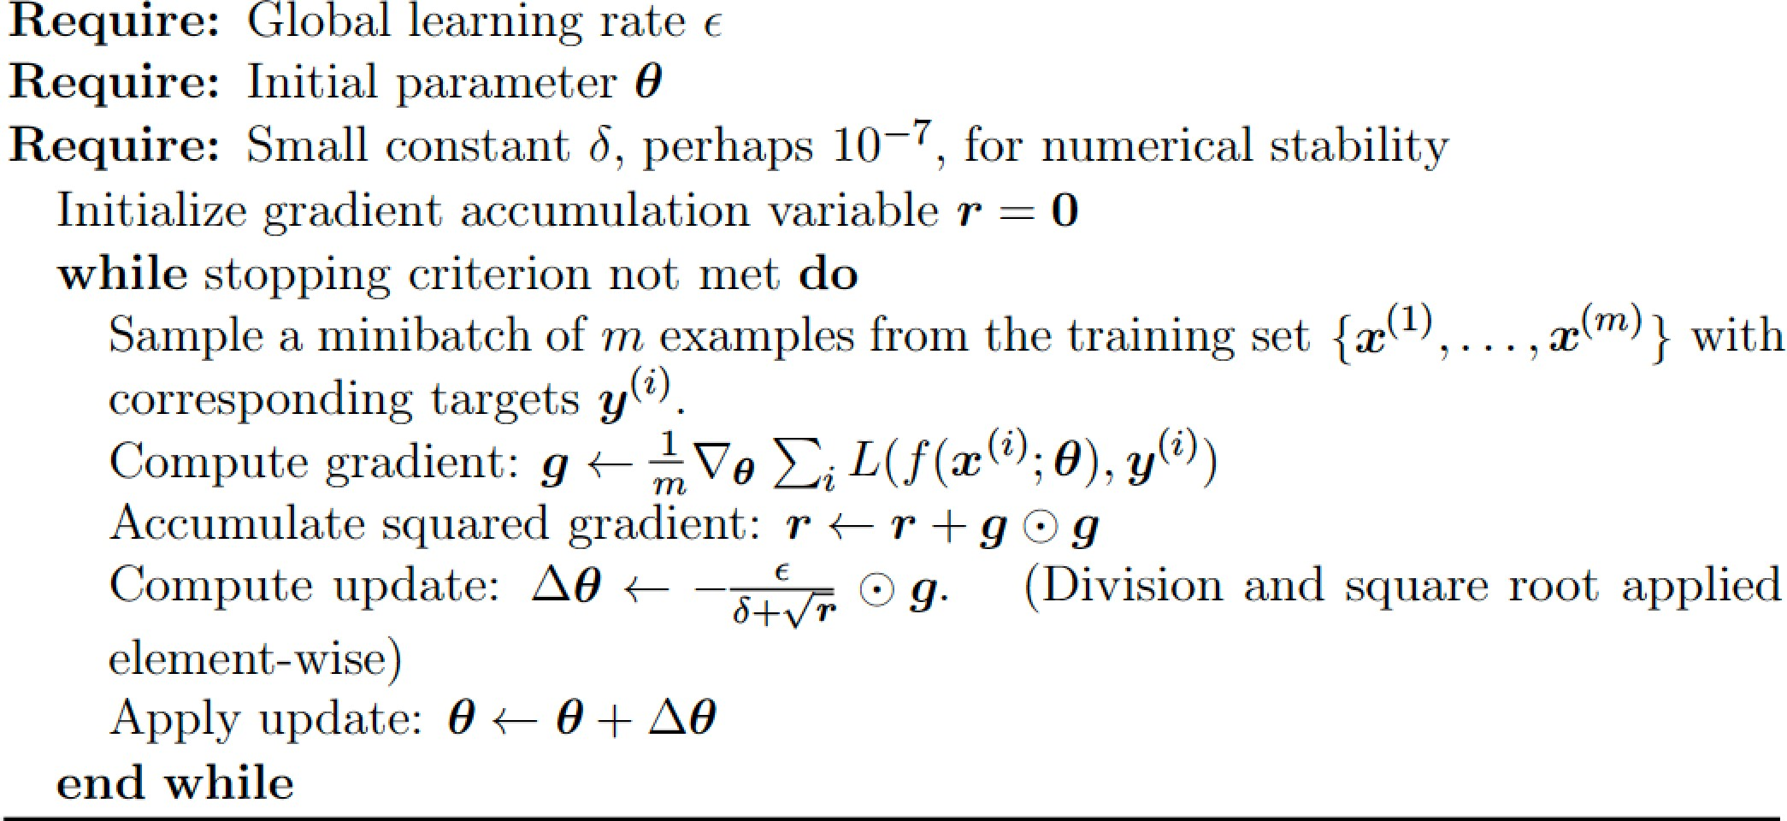
AdaGrad
Individually adapts learning rates of all params
– By scaling them inversely proportional to the sum of the historical squared values of the gradient
The AdaGrad Algorithm:
Performs well for some but not all
6

Slide 92
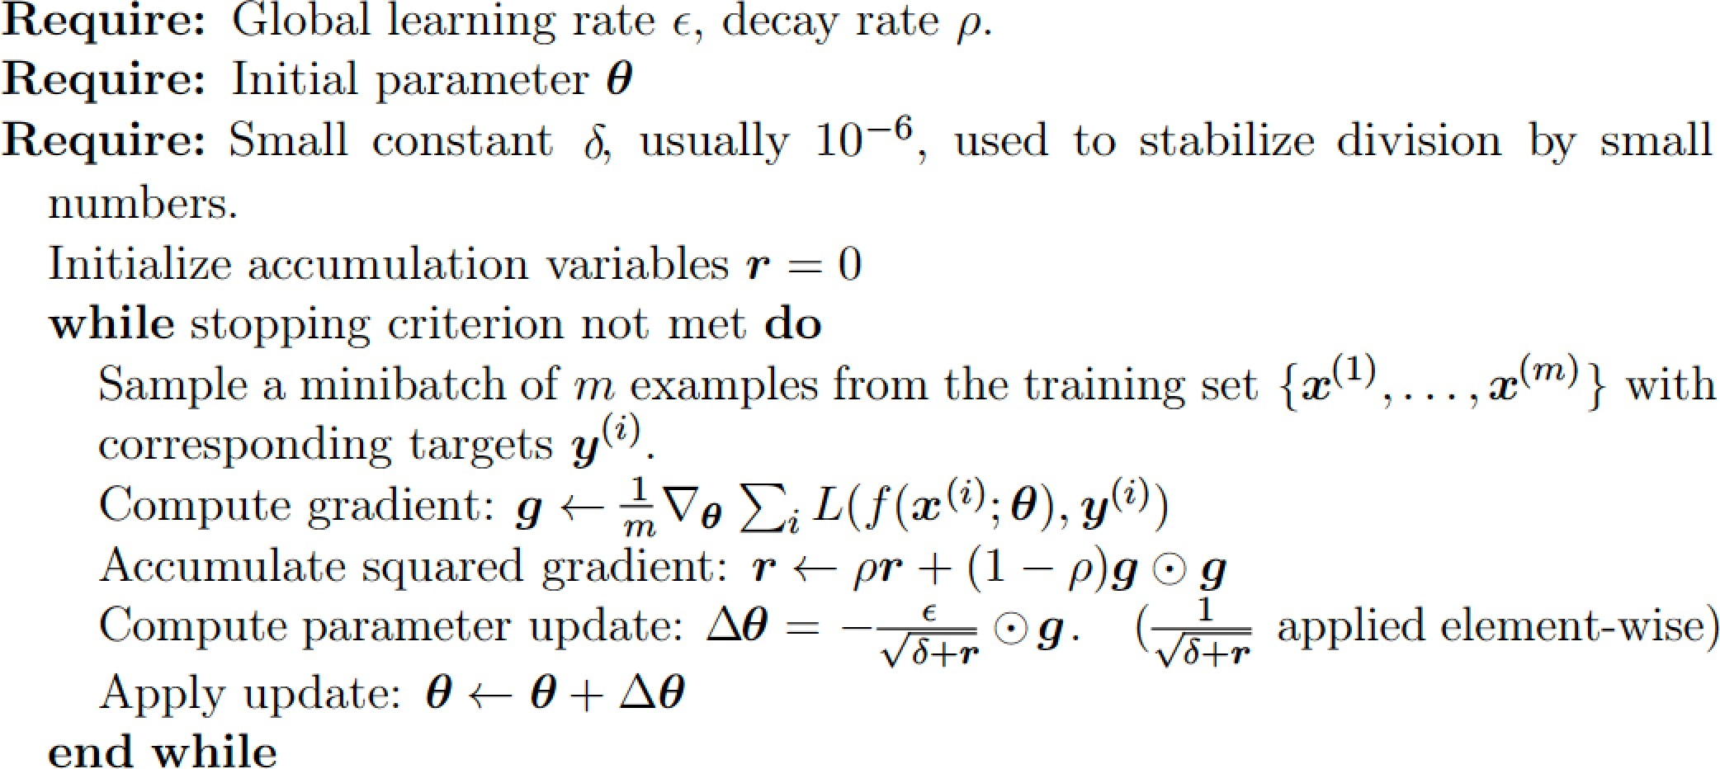
RMSProp
Modifies AdaGrad for a nonconvex setting
Change gradient accumulation into exponentially weighted moving average
Converges rapidly when applied to convex function
The RMSProp Algorithm

Slide 93
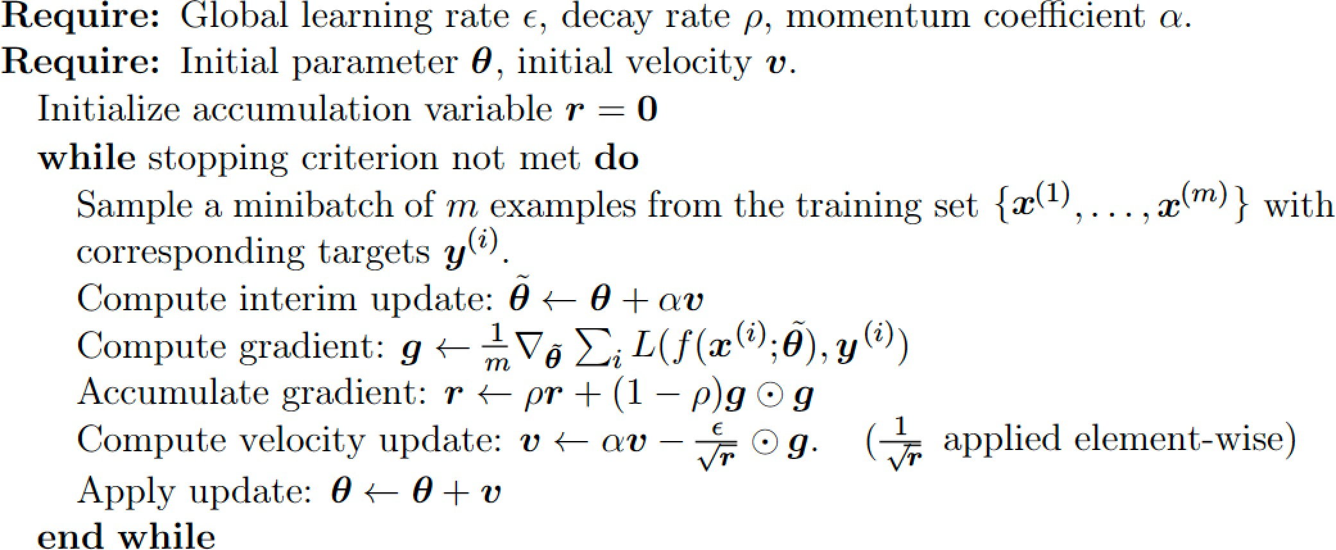
RMSProp combined with Nesterov
Algorithm: RMSProp with Nesterov momentum

Slide 94
RMSProp is popular
RMSProp is an effective practical optimization algorithm
Go-to optimization method for practitioners

Slide 95
Adam: Adaptive Moments
Yet another adaptive learning rate optimization algorithm
Variant of RMSProp with momentum
Generally robust to the choice of hyperparameters

Slide 96
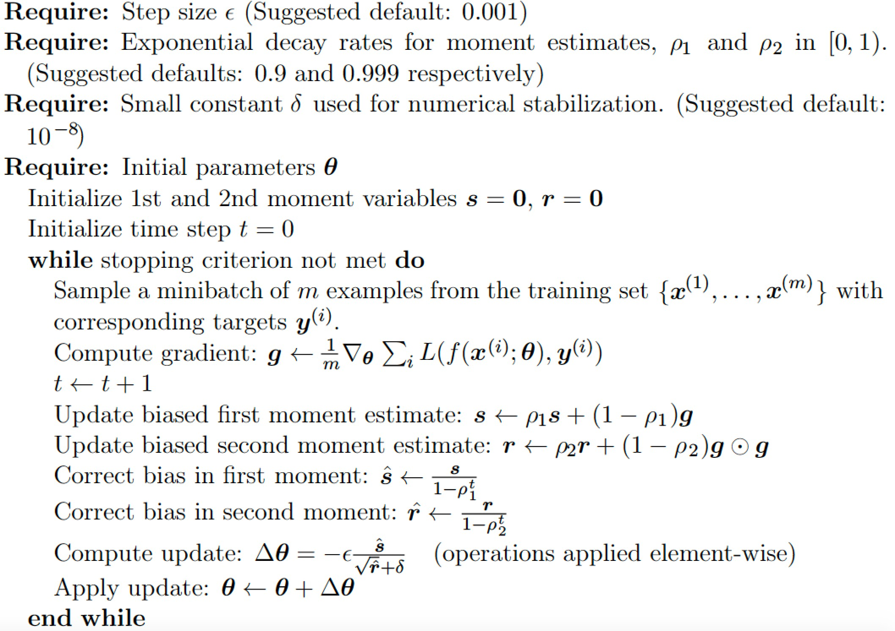
The Adam Optimizer
The Adam Algorithm

Slide 97
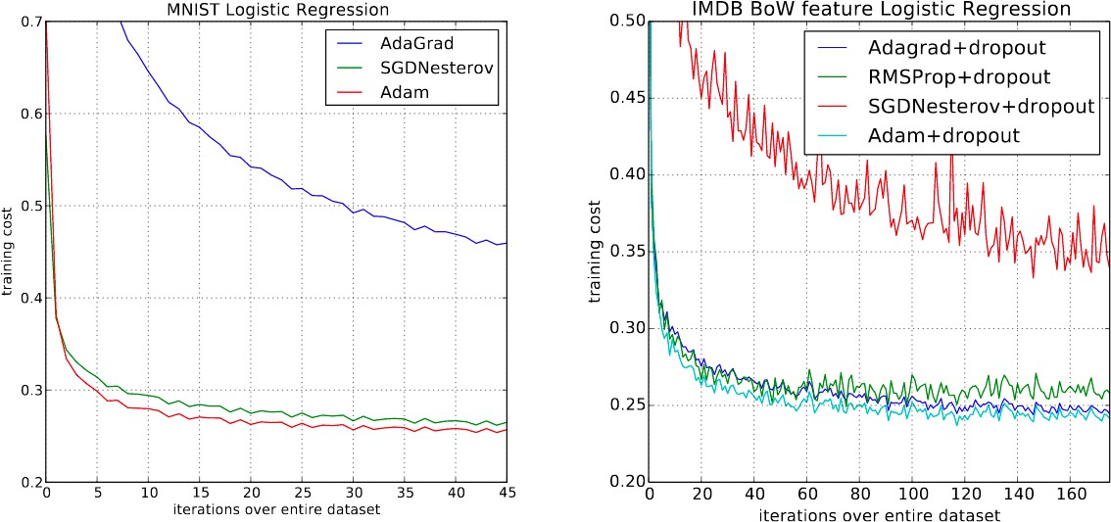
Performance in Logistic Regression
Logistic regression training negative log likelihood on MNIST images and IMDB movie reviews with 10,000 bag-of-words (BoW) feature vectors.

Slide 98
Performance on Multilayer NN
Training of multilayer neural networks on MNIST images. (a) Neural networks using dropout stochastic regularization. (b) Neural networks with deterministic cost function.

Slide 99
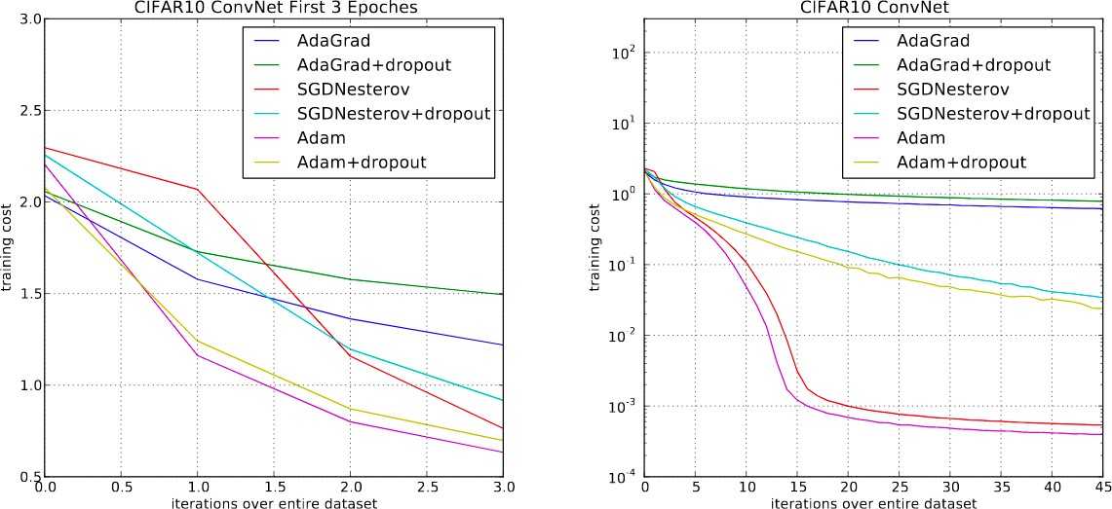
Performance with CNN
Convolutional neural networks training cost. (left) Training cost for the first three epochs. (right) Training cost over 45 epochs.
CIFAR-10 with c64-c64-c128-1000 architecture.

Slide 100
Choosing the Right Optimizer
We have discussed several methods of optimizing deep models by adapting the learning rate for each model parameter
Which algorithm to choose?
There is no consensus
Most popular algorithms actively in use:
SGD, SGD with momentum, RMSProp, RMSProp with momentum, AdaDelta and Adam
Choice depends on user’s familiarity with algorithm

